Slide 1
Reddit and yahoo finance data analysis
Dave Burgman, Ian Lee, Navdeep Kaur, April Holmes, Chris Avallon

Slide 2
OVERVIEW
This project retrieves data from Yahoo Finance and Reddit, performs analysis, and visualizes the relationship between Reddit upvotes and comments. It also fetches historical stock data for a specific symbol from Yahoo Finance and conducts a linear regression analysis. This project involves the analysis of data from the Wall-Streeters' subreddit on Reddit and financial data from Yahoo Finance, focusing on Tesla, Inc.
Goal: To explore potential correlations between Reddit post engagement (upvotes and comments) and stock market performance.

Slide 3
hypothesis
Alternate Hypothesis
Social media activity (within a specific Reddit community) surrounding a company is correlated to stock performance
Null Hypothesis
Social media activity does not correlate to stock performance

Slide 4
DATA SOURCES
REDDIT
YAHOO
https://www.reddit.com/prefs/apps
Yahoo Finance - Stock Market Live, Quotes, Business & Finance News
dependencies
Praw:(Python Reddit API Wrapper) is a Python library that provides a convenient way to interact with the Reddit API. It simplifies the process of accessing and retrieving data from Reddit, allowing us to easily create monitor subreddits, and perform various actions on the platform.
Requests: Popular Python Library that simplifies sending Http requests and handling responses.
Used this library for making an Api call to Yahoo and reddit API’s .
Pandas: Padas allows you to load datasets from various formats like CSV,EXCEL,JSON,or SQL databases. We used this library for generating data frames of big yahoo finance and Reddit data.
Datetime:Used this module to specific components from the datetime object and format datetime from UTC format to datetime format.
Json: A format that is easy for humans to read and write, It's a key-value pair format .Used this for grabbing the yahoo URL, stock symbol and converting them to Json.
Matplotlib: Popular data visualization library in python. Used this library to perform Linear Regression on Reedit upvotes and comments, yahoo prices.
NumPy: A Library provides support for large multidimensional arrays and matrices.
SciPy. Stats: Used this Library while working on various computational tasks, leading to solve complex problems efficiently.

Slide 5
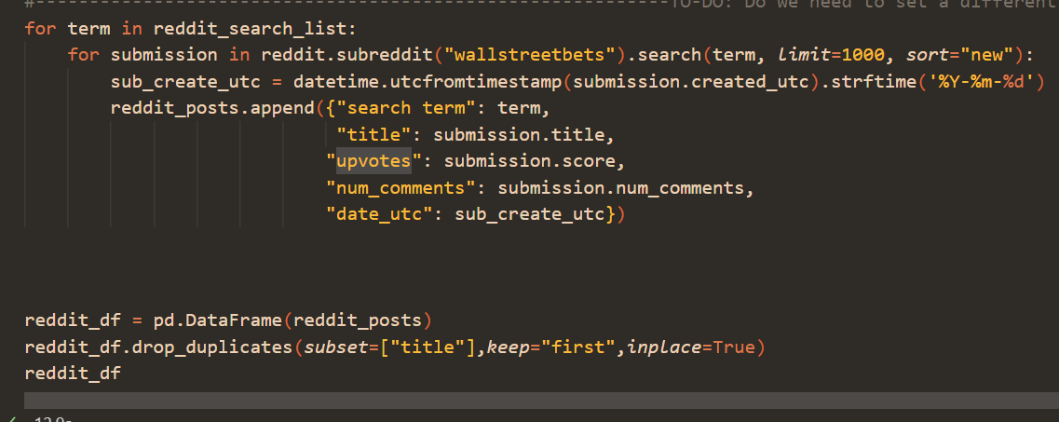
Data exploration and cleaning (reddit)
Social media search
Api packages
Google
Youtube
RedditAPI
praw
API wrapper

Slide 6
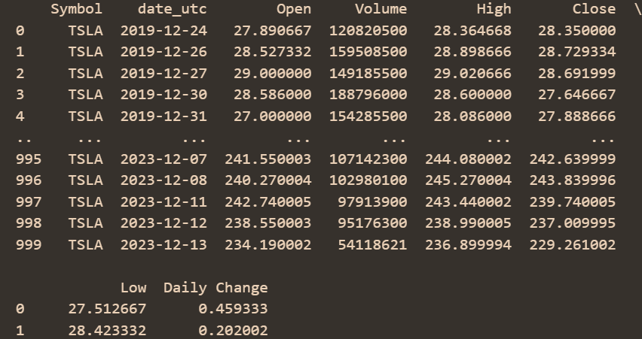
Data exploration and cleaning (Yahoo)
Rapid api
Extracting data
Merging
Yahoo Finance API
API Key
URL
pd.merge(reddit_df, yahoo_finance_df)
Testing data
Removing outliers
Sorting dates

Slide 7
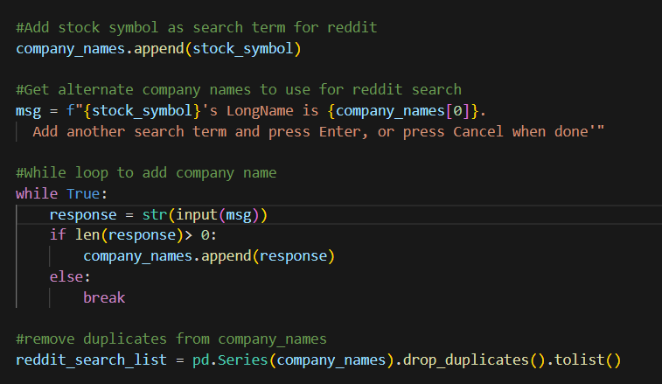
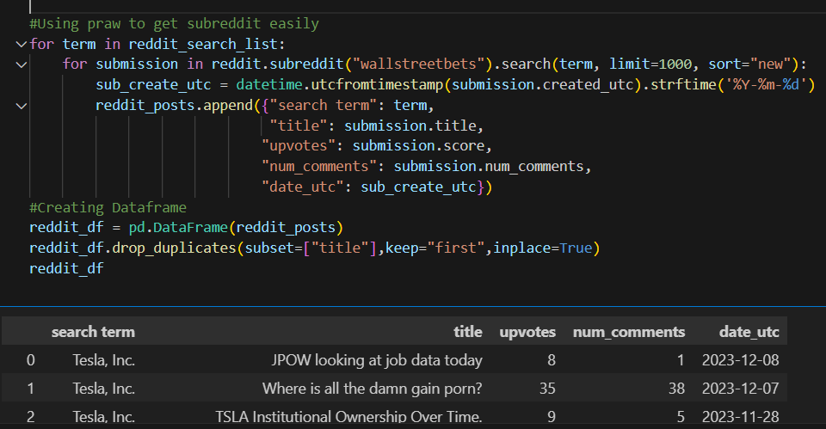
Data Cleaning
Ticker/Company selection
- For flexibility, added an input prompt to set stock ticker to search and added the option to input additional company names. (Ex. TSLA ticker, company name is “Tesla, Inc”. You can add “Tesla”)
- As part of data cleaning, removed any duplicates entered before searching.
Date formatting
For both Yahoo and Reddit, converted dates from timestamp to a more common date format (Ex 1706007540 to 2024-01-23)

Slide 8
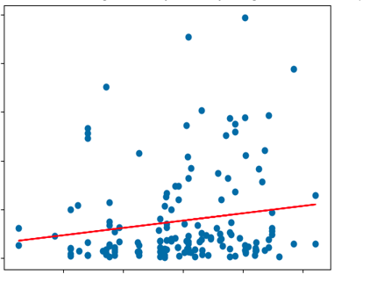
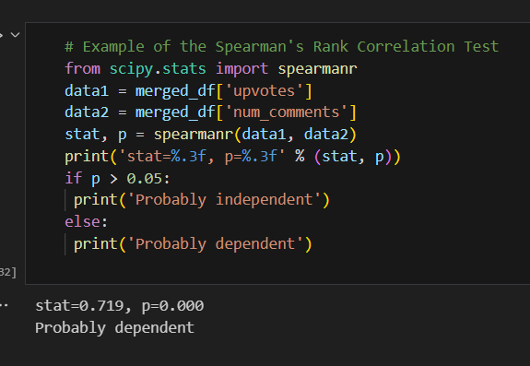
Data analysis
Reddit mentions vs stock price
From Yahoo, extracted key financial indicators for a selected stock (TSLA) and obtained historical stock price data for the past 100 days.
From Reddit, conducted a search for posts containing the ticker or company name and extracted number of comments and upvotes to determine mentions.
Conducted a linear regression analysis on the selected stock’s daily change vs. comments to explore their relationship. Ran Spearman’s Rank Correlation Test to determine dependency.

Slide 9
conclusions
Reddit Engagement vs. Stock Performance: Analyzed the relationship between Reddit post engagement and Tesla stock performance. The linear regression analysis suggests a positive correlation between upvotes and comments, indicating higher engagement for certain stock-related posts.
Historical Stock Performance: Explored historical stock prices for Tesla, Inc. over the past 100 days. Visualized trends and patterns in the stock's performance.

Slide 10
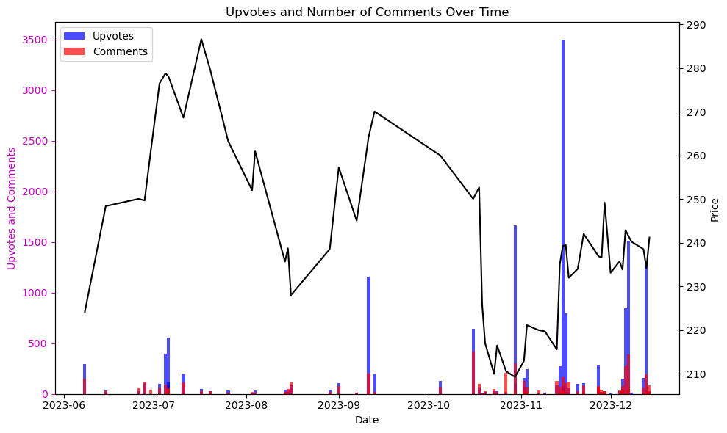
conclusions
Price change and frequency of mentions seem to have only a slight correlation, however the topography of price changes and social media mentions are similar
Using live data which tracks mentions rather than sentiment, the statistical correlation between the two datasets will be constantly changing. However, we can still use this visualization to track social media’s impact on historical price movement as well as the inverse (price movement affecting frequency of mentions) and use this information to find sleeper stocks, identify targeted price manipulation, and predict trades within the market and amongst members of WallStreetBets

Slide 11
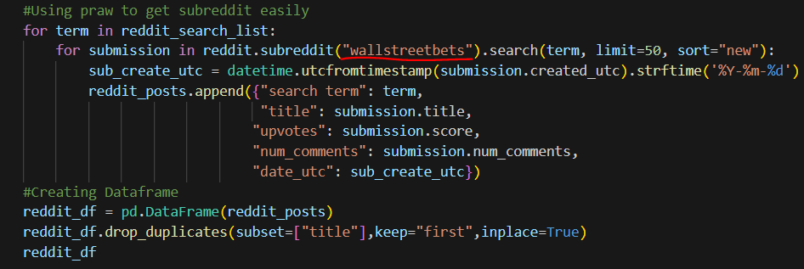
implications
Suggestions for further analysis
Sentiment Analysis: Incorporate sentiment analysis on Reddit comments to understand the overall sentiment of the community towards specific stocks.
Volume Analysis: Explore the correlation between stock trading volume and Reddit engagement to identify potential trends or anomalies.
Reddit comments and upvotes are a low-confidence indicator of price movement on the stock market
Price manipulation by the WallStreetBets group can be visualized by tracking the frequency of mentions along with price stability and subsequent rise in price
This application can be edited to perform the same analysis on any subreddit

Slide 12
ACKNOWLEDGEMENTS
Data sourced from Yahoo Finance and Reddit.
Special thanks to the developers of the used libraries and APIs.

